Slide 1
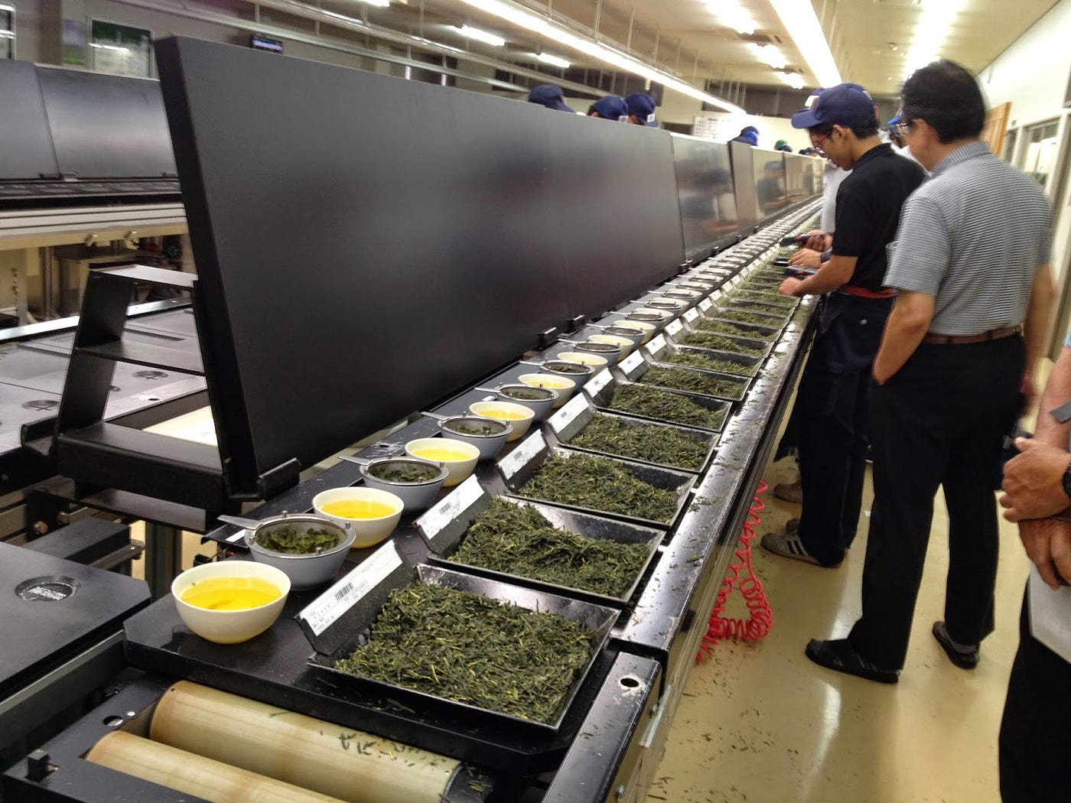

SCIENCE OF TASTE
This week’s Topic
A tea buyer tastes a selection of teas.

Slide 2
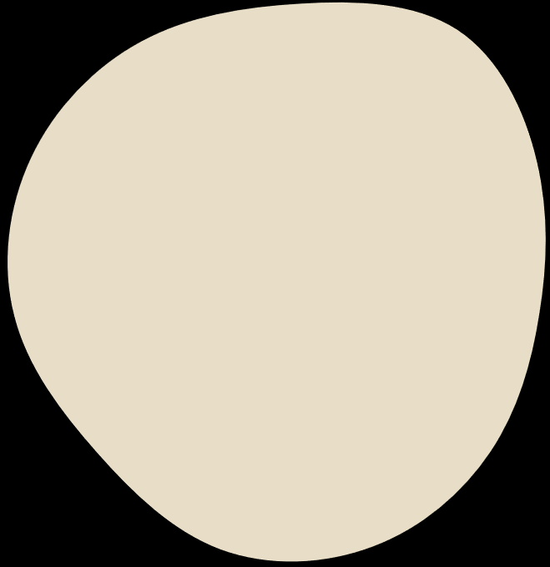

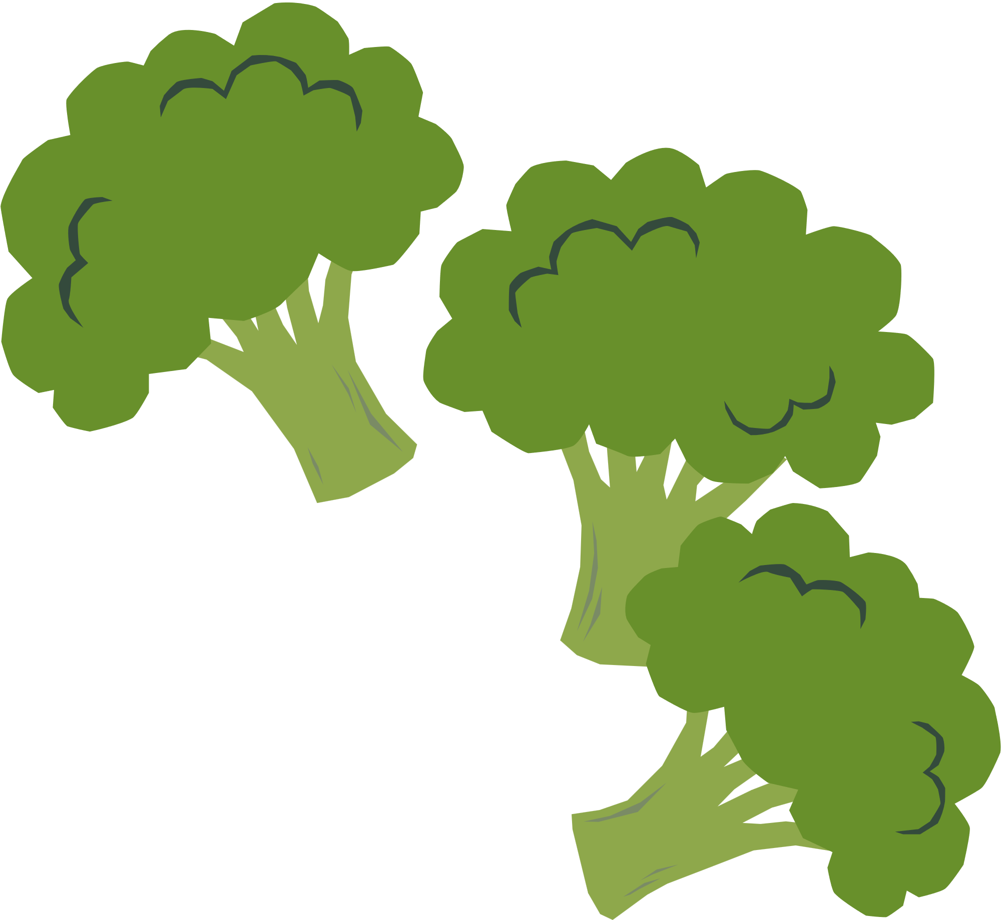
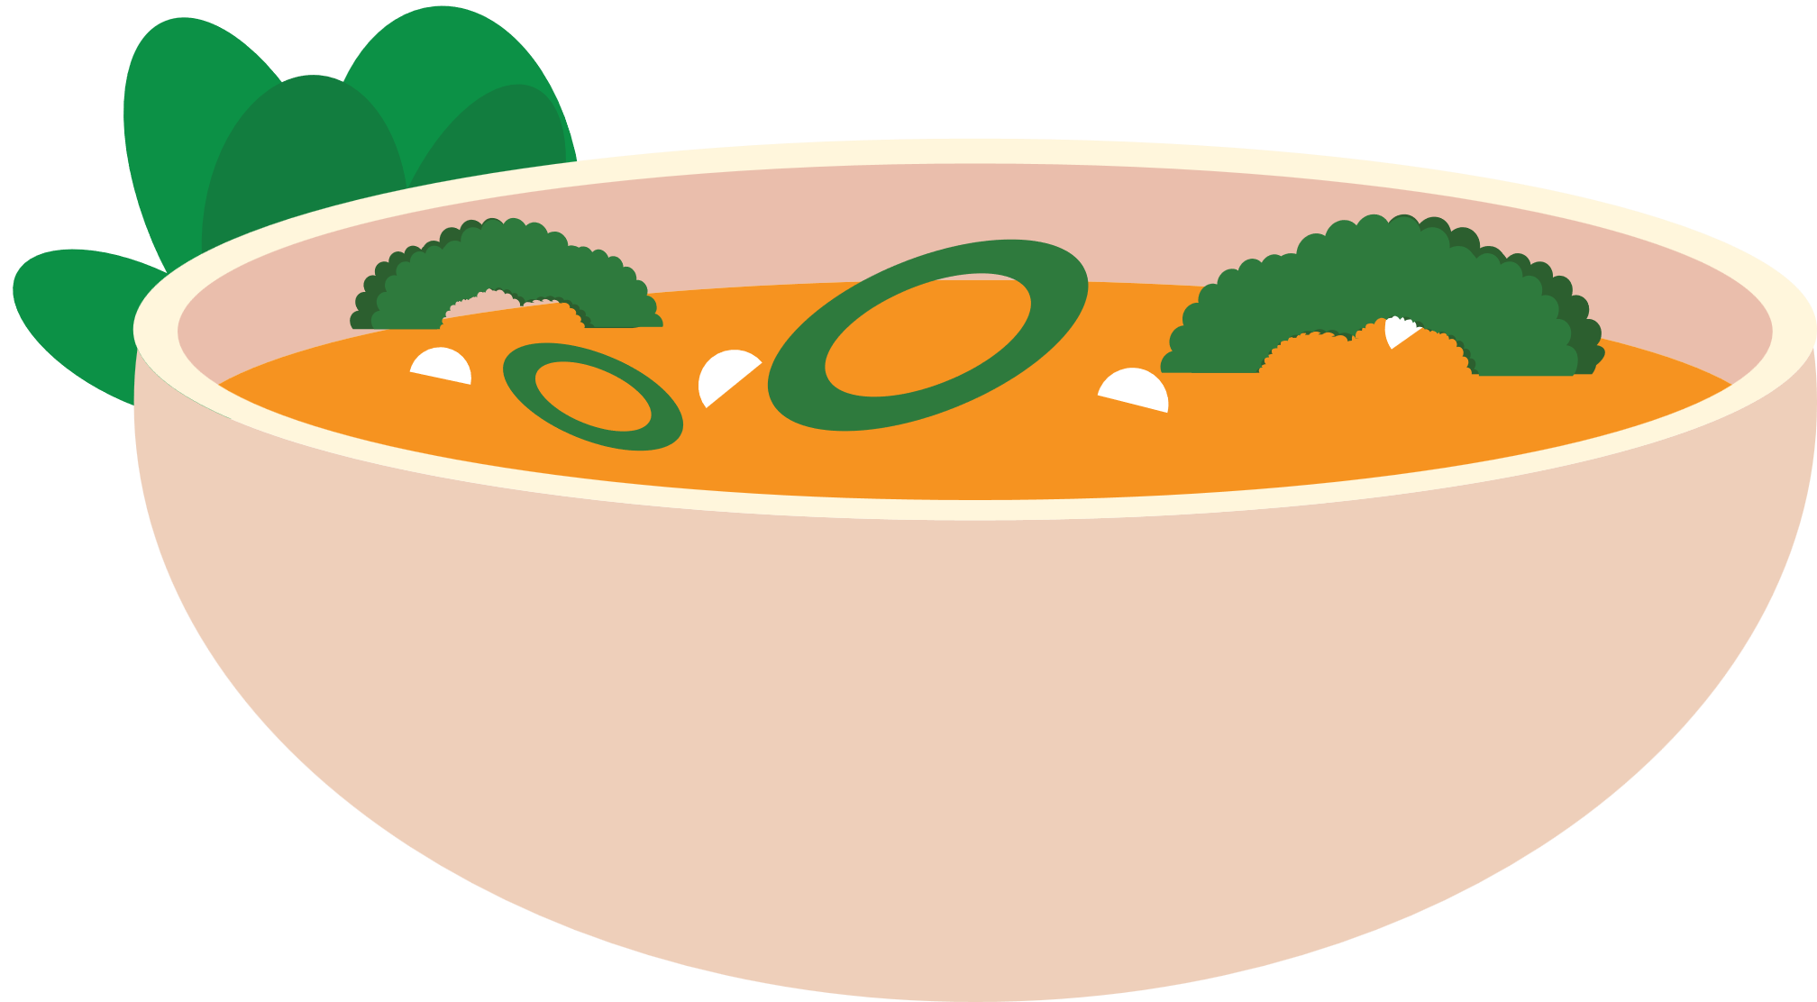
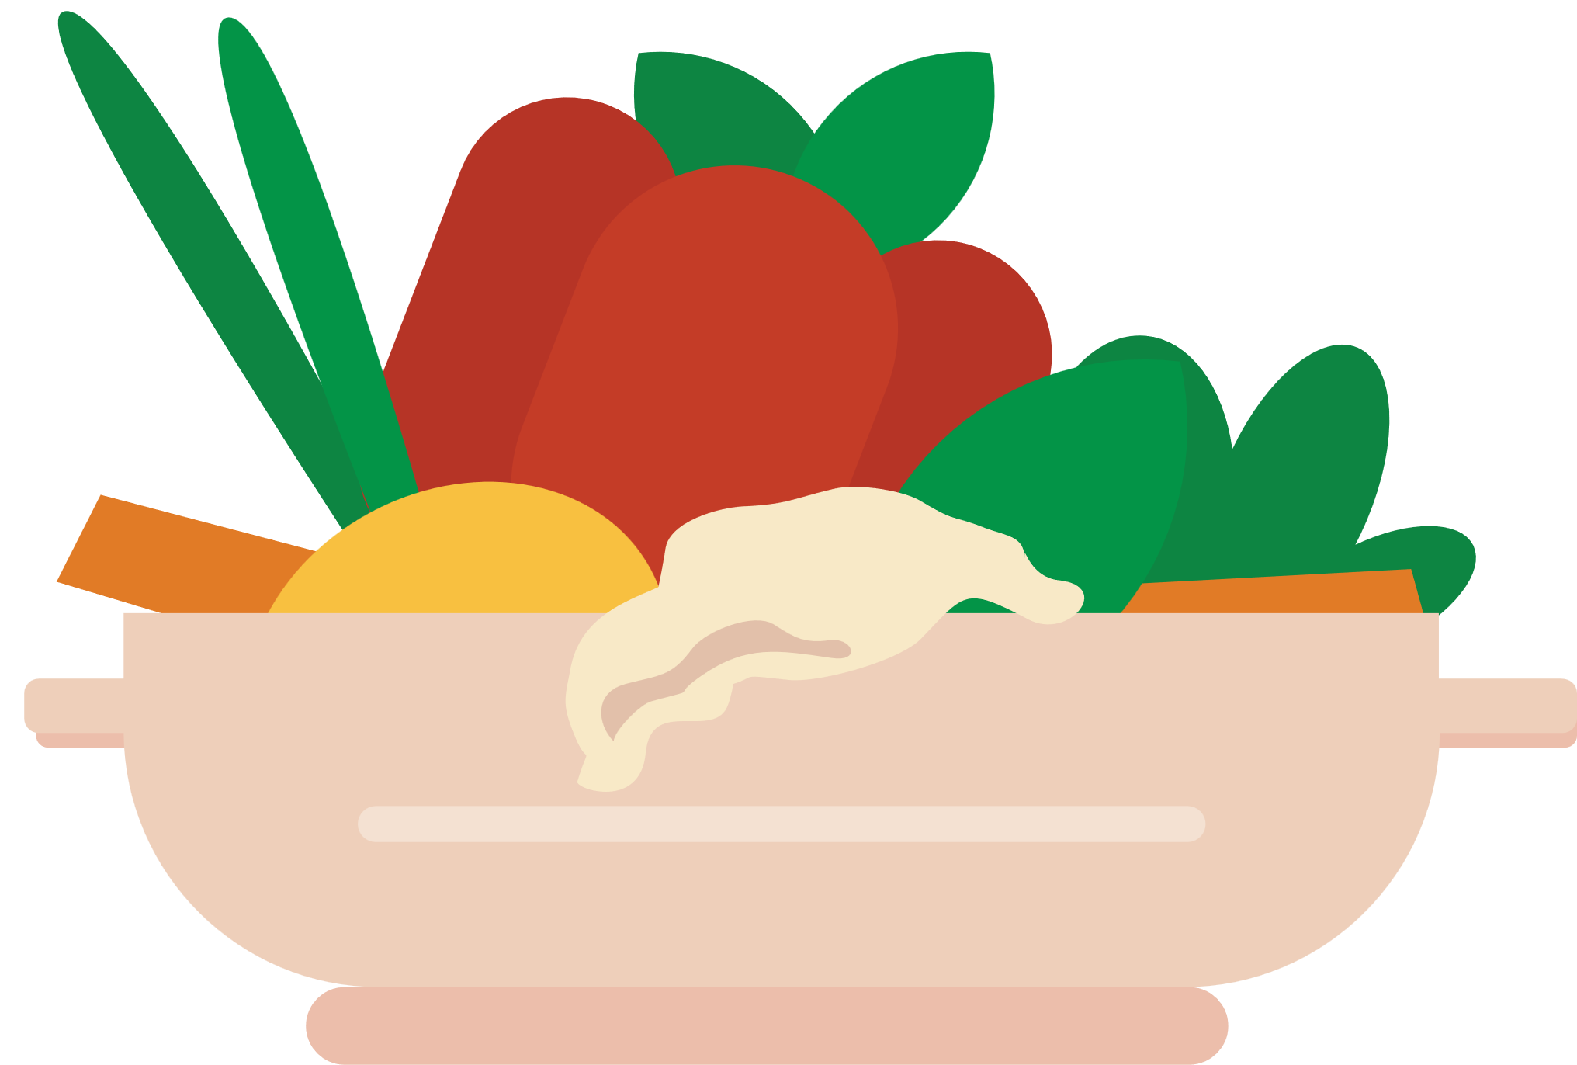
Warm up
Red
Yellow
Do you know color can affect how we taste food? Can you name some colors commonly associated with flavors?
Green
White
Black
Orange

Slide 3
Warm up
Red
Yellow
Sweet or fruity
Sweet or citrusy
Do you know color can affect how we taste food? Can you name some colors commonly associated with flavors?
Green
White
Sour or fresh
Mild or salty
Black
Orange
Bitter
Sweet and tangy

Slide 4
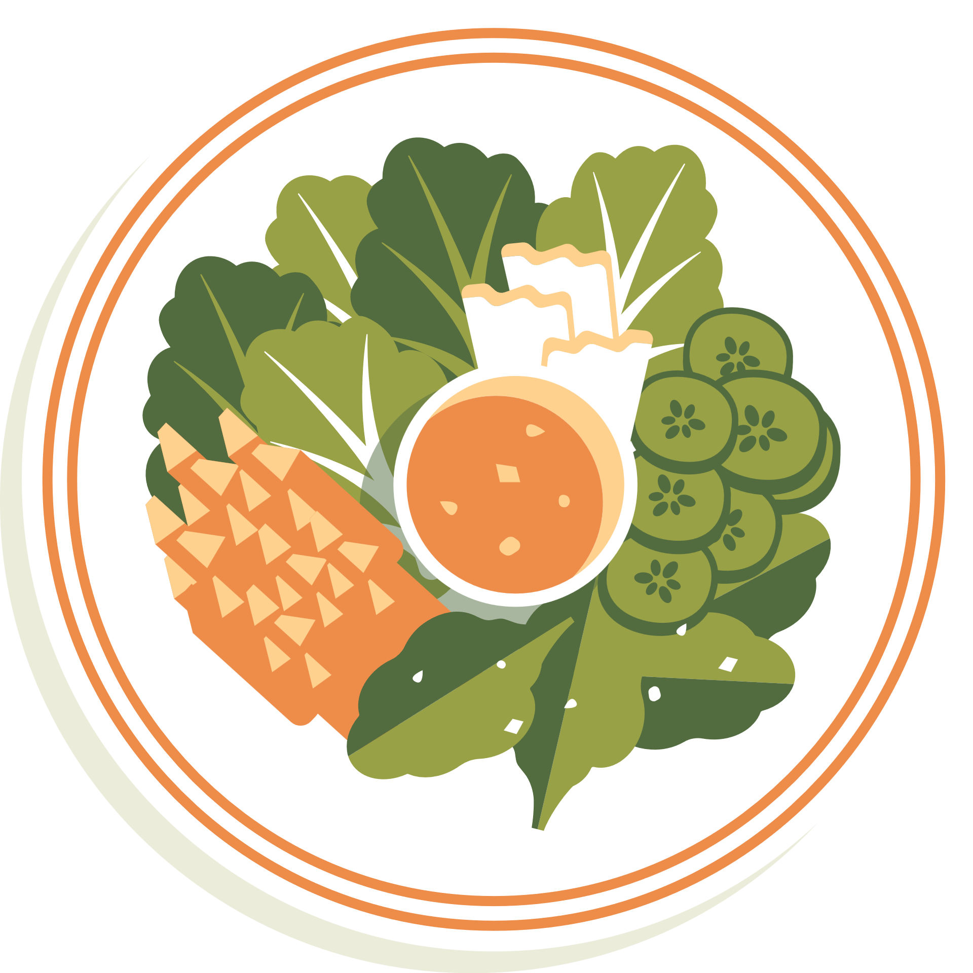


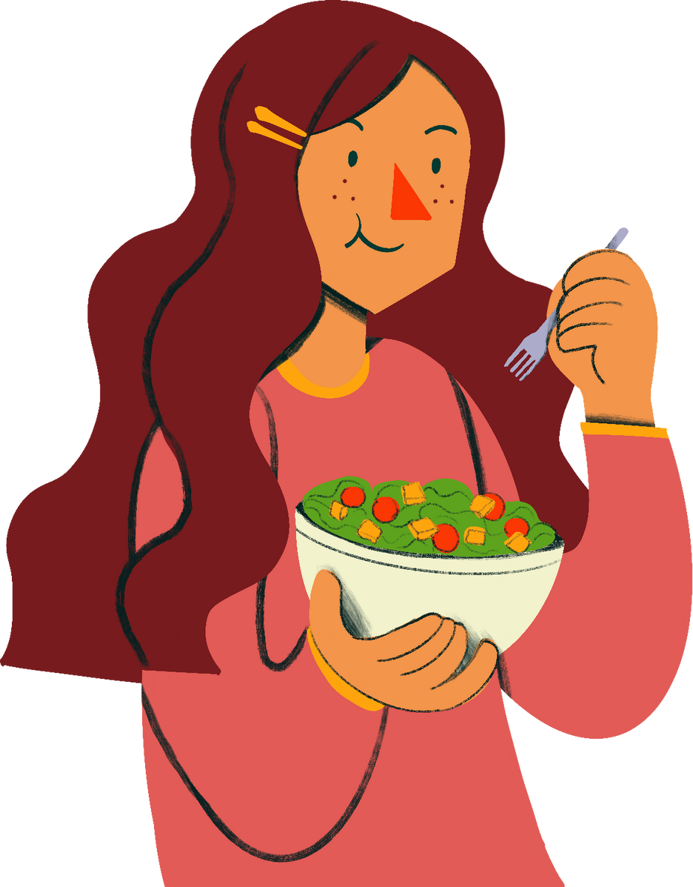

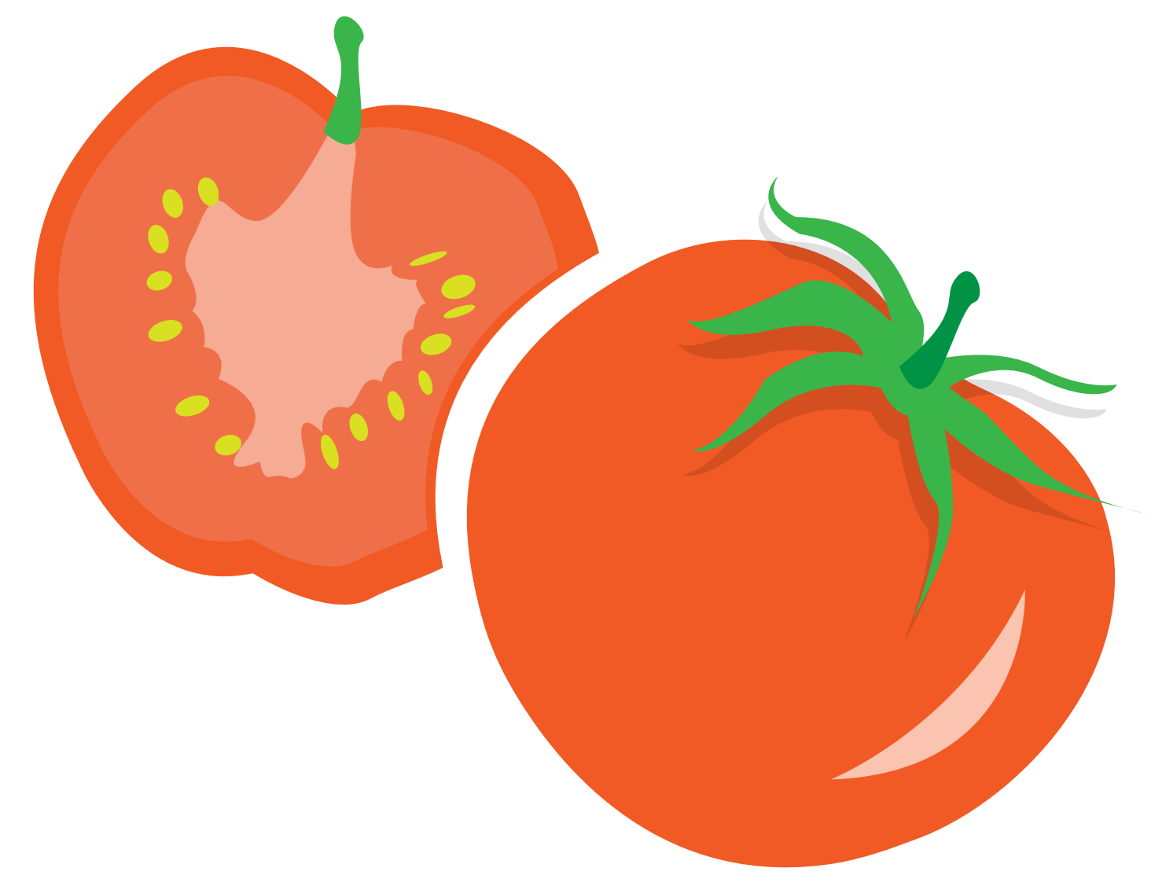
Read the information. The words in bold appear in the video. Match each word with the type of food it describes.
Sweet
potato chips
Salty
candy
Sour
dark chocolate
Bitter
lime

Slide 5




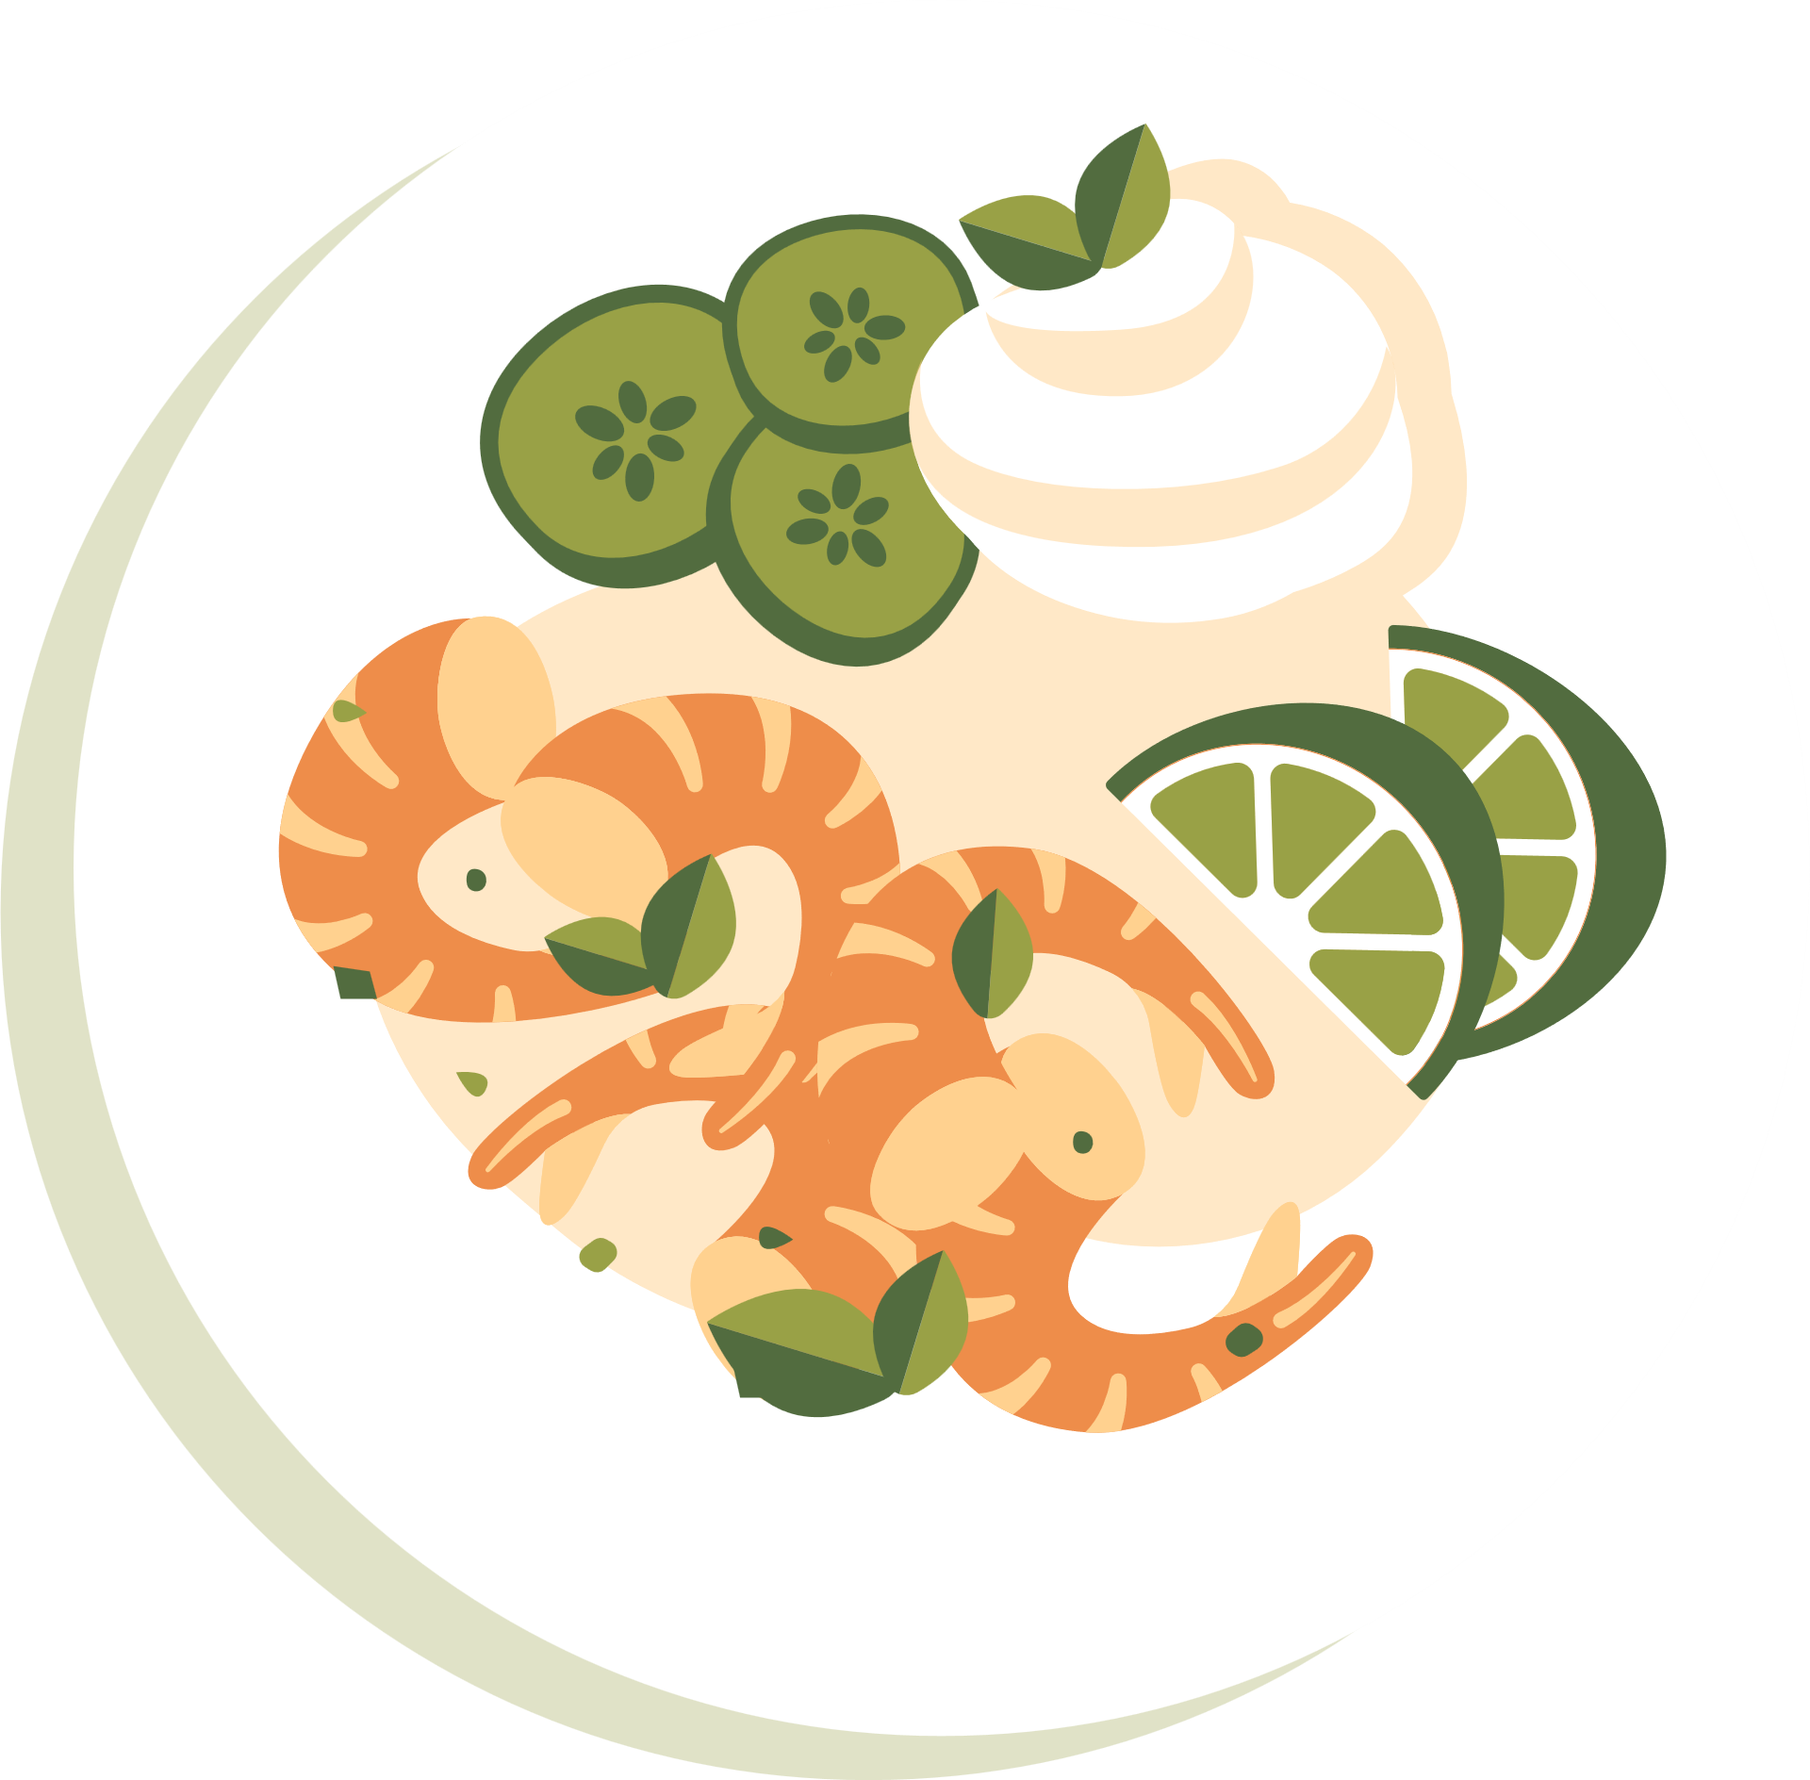
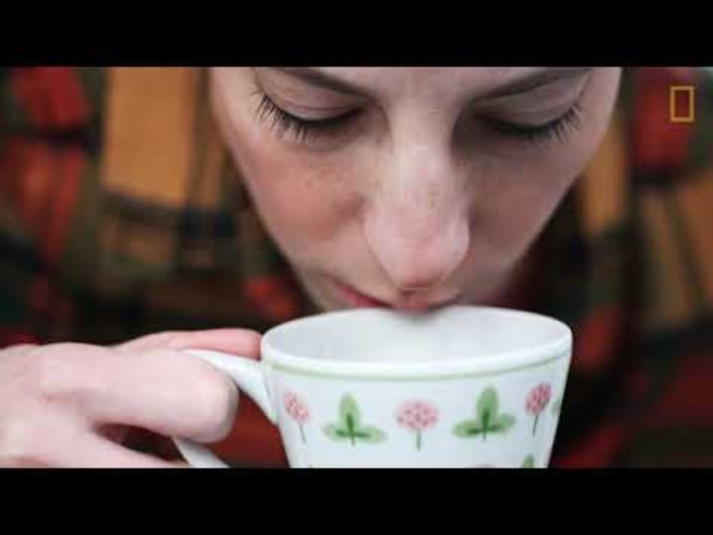

Watch the video. What senses do we use when we taste food?
Notes:
https://www.youtube.com/watch?v=etwvJg1kQNc

Slide 6
Checking answers!
Sweet
candy
Salty
potato chips
Sour
lime
Bitter
dark chocolate
Notes:
Sweet → b. candy
Salty → a. potato chips
Sour → d. lime
Bitter → c. dark chocolate

Slide 7
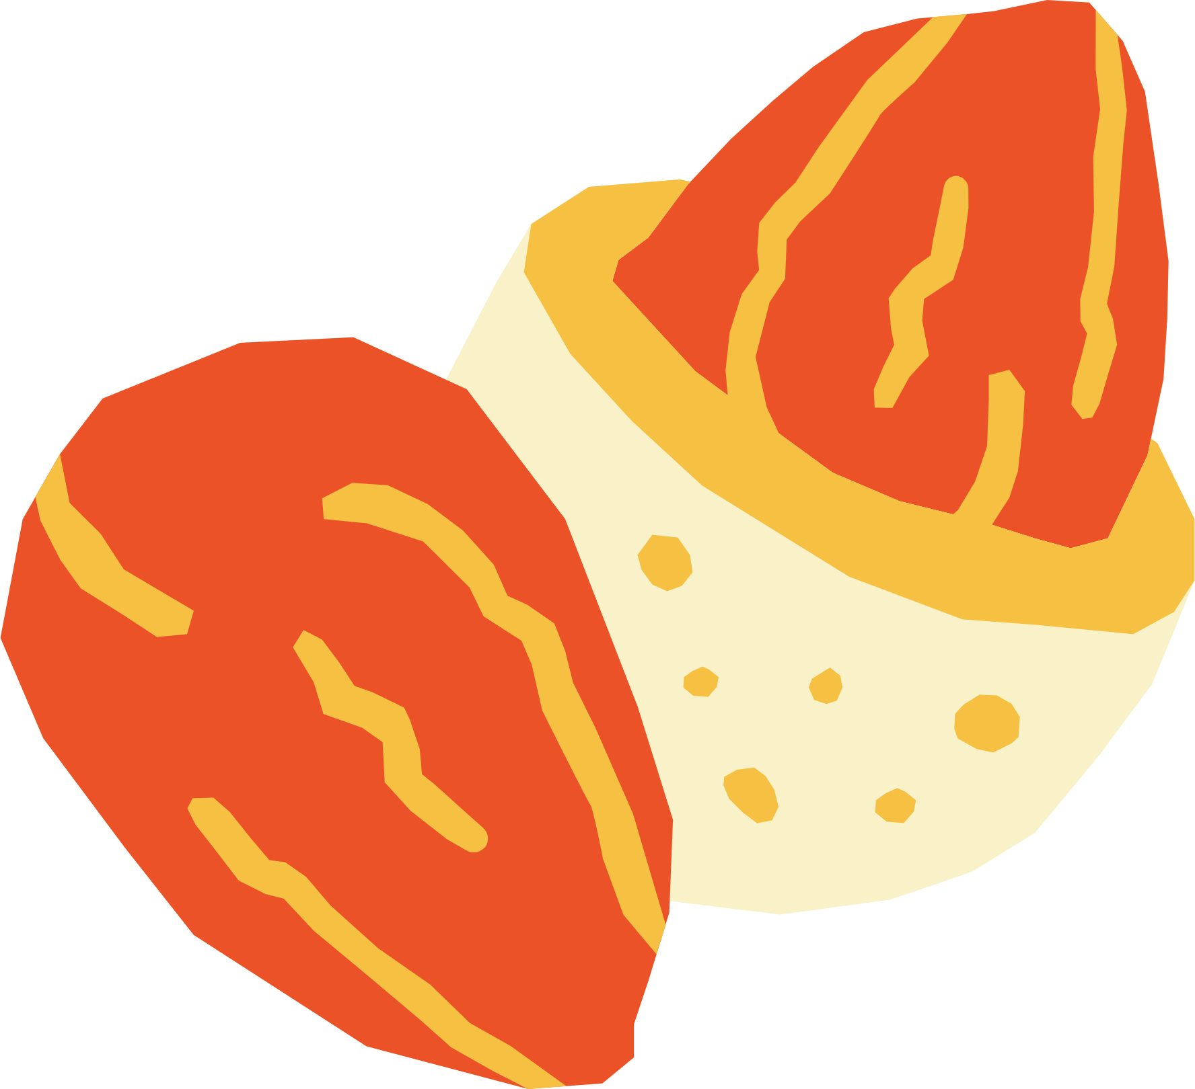




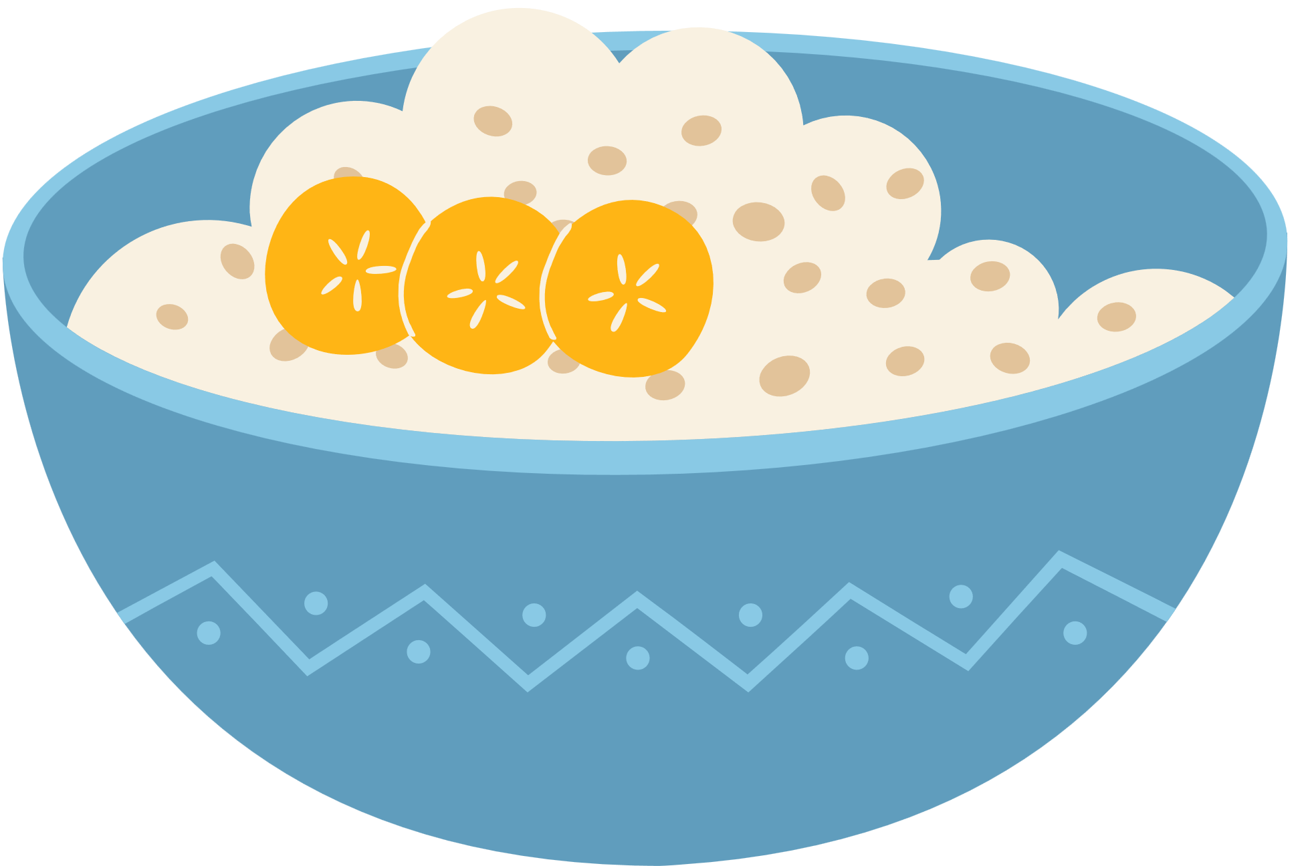
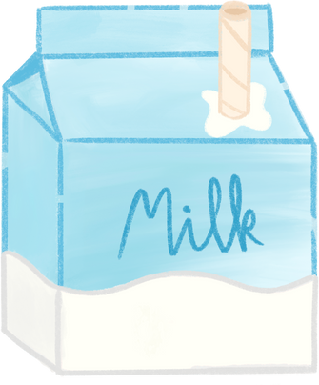
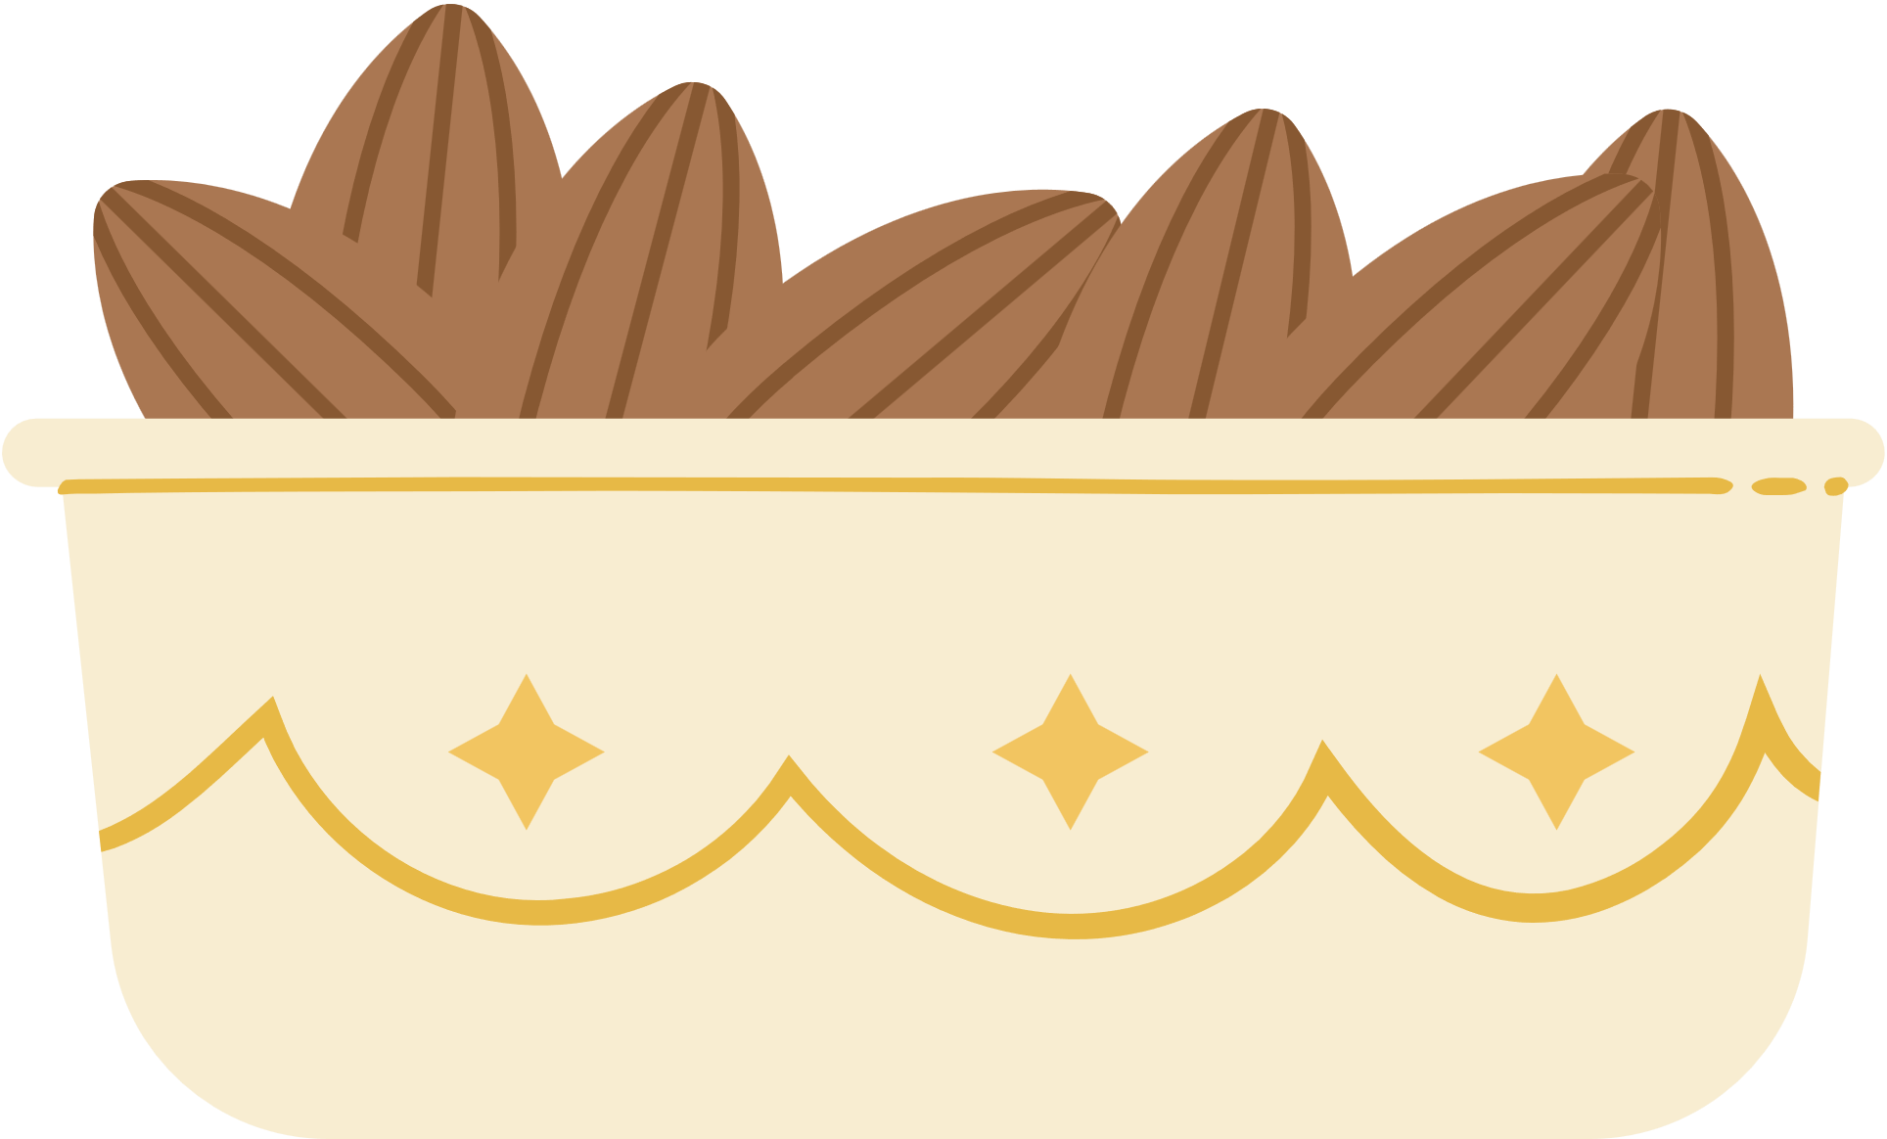
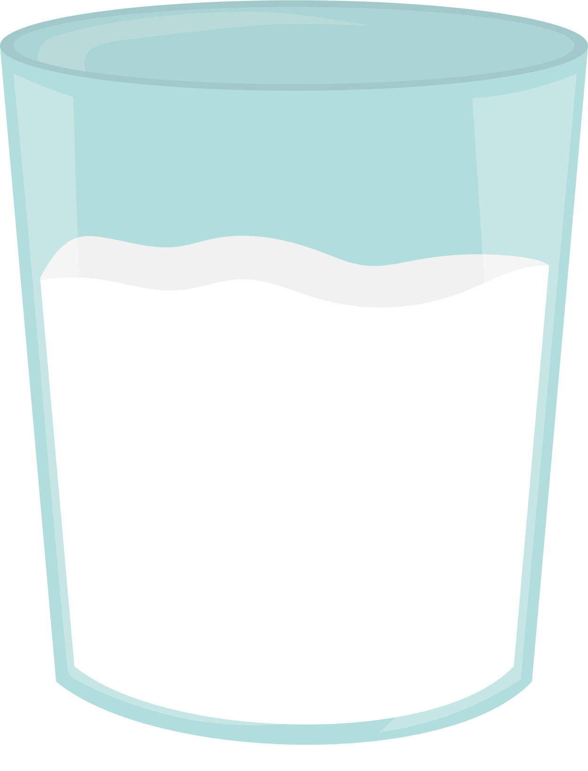
Watch the video again. Complete the sentences with the words and phrases (a–d) in the box. Each option can be used more than once.
a. more bitter | b. saltier | c. more sour | d. sweeter
1. Red food tastes _________.
2. Green food tastes _______.
3. Black food tastes ________.
4. White food tastes ________.
5. Food on a round plate tastes ________.
6. Food on a square plate tastes ________.
Notes:
https://www.youtube.com/watch?v=etwvJg1kQNc

Slide 8
Watch the video again. Complete the sentences with the words and phrases (a–d) in the box. Each option can be used more than once.
a. more bitter | b. saltier | c. more sour | d. sweeter
1. Red food tastes sweeter.
2. Green food tastes more sour.
3. Black food tastes more bitter.
4. White food tastes saltier.
5. Food on a round plate tastes sweeter.
6. Food on a square plate tastes more bitter.
Notes:
https://www.youtube.com/watch?v=etwvJg1kQNc
d. sweeter
c. more sour
a. more bitter
b. saltier
d. sweeter
a. more bitter

Slide 9
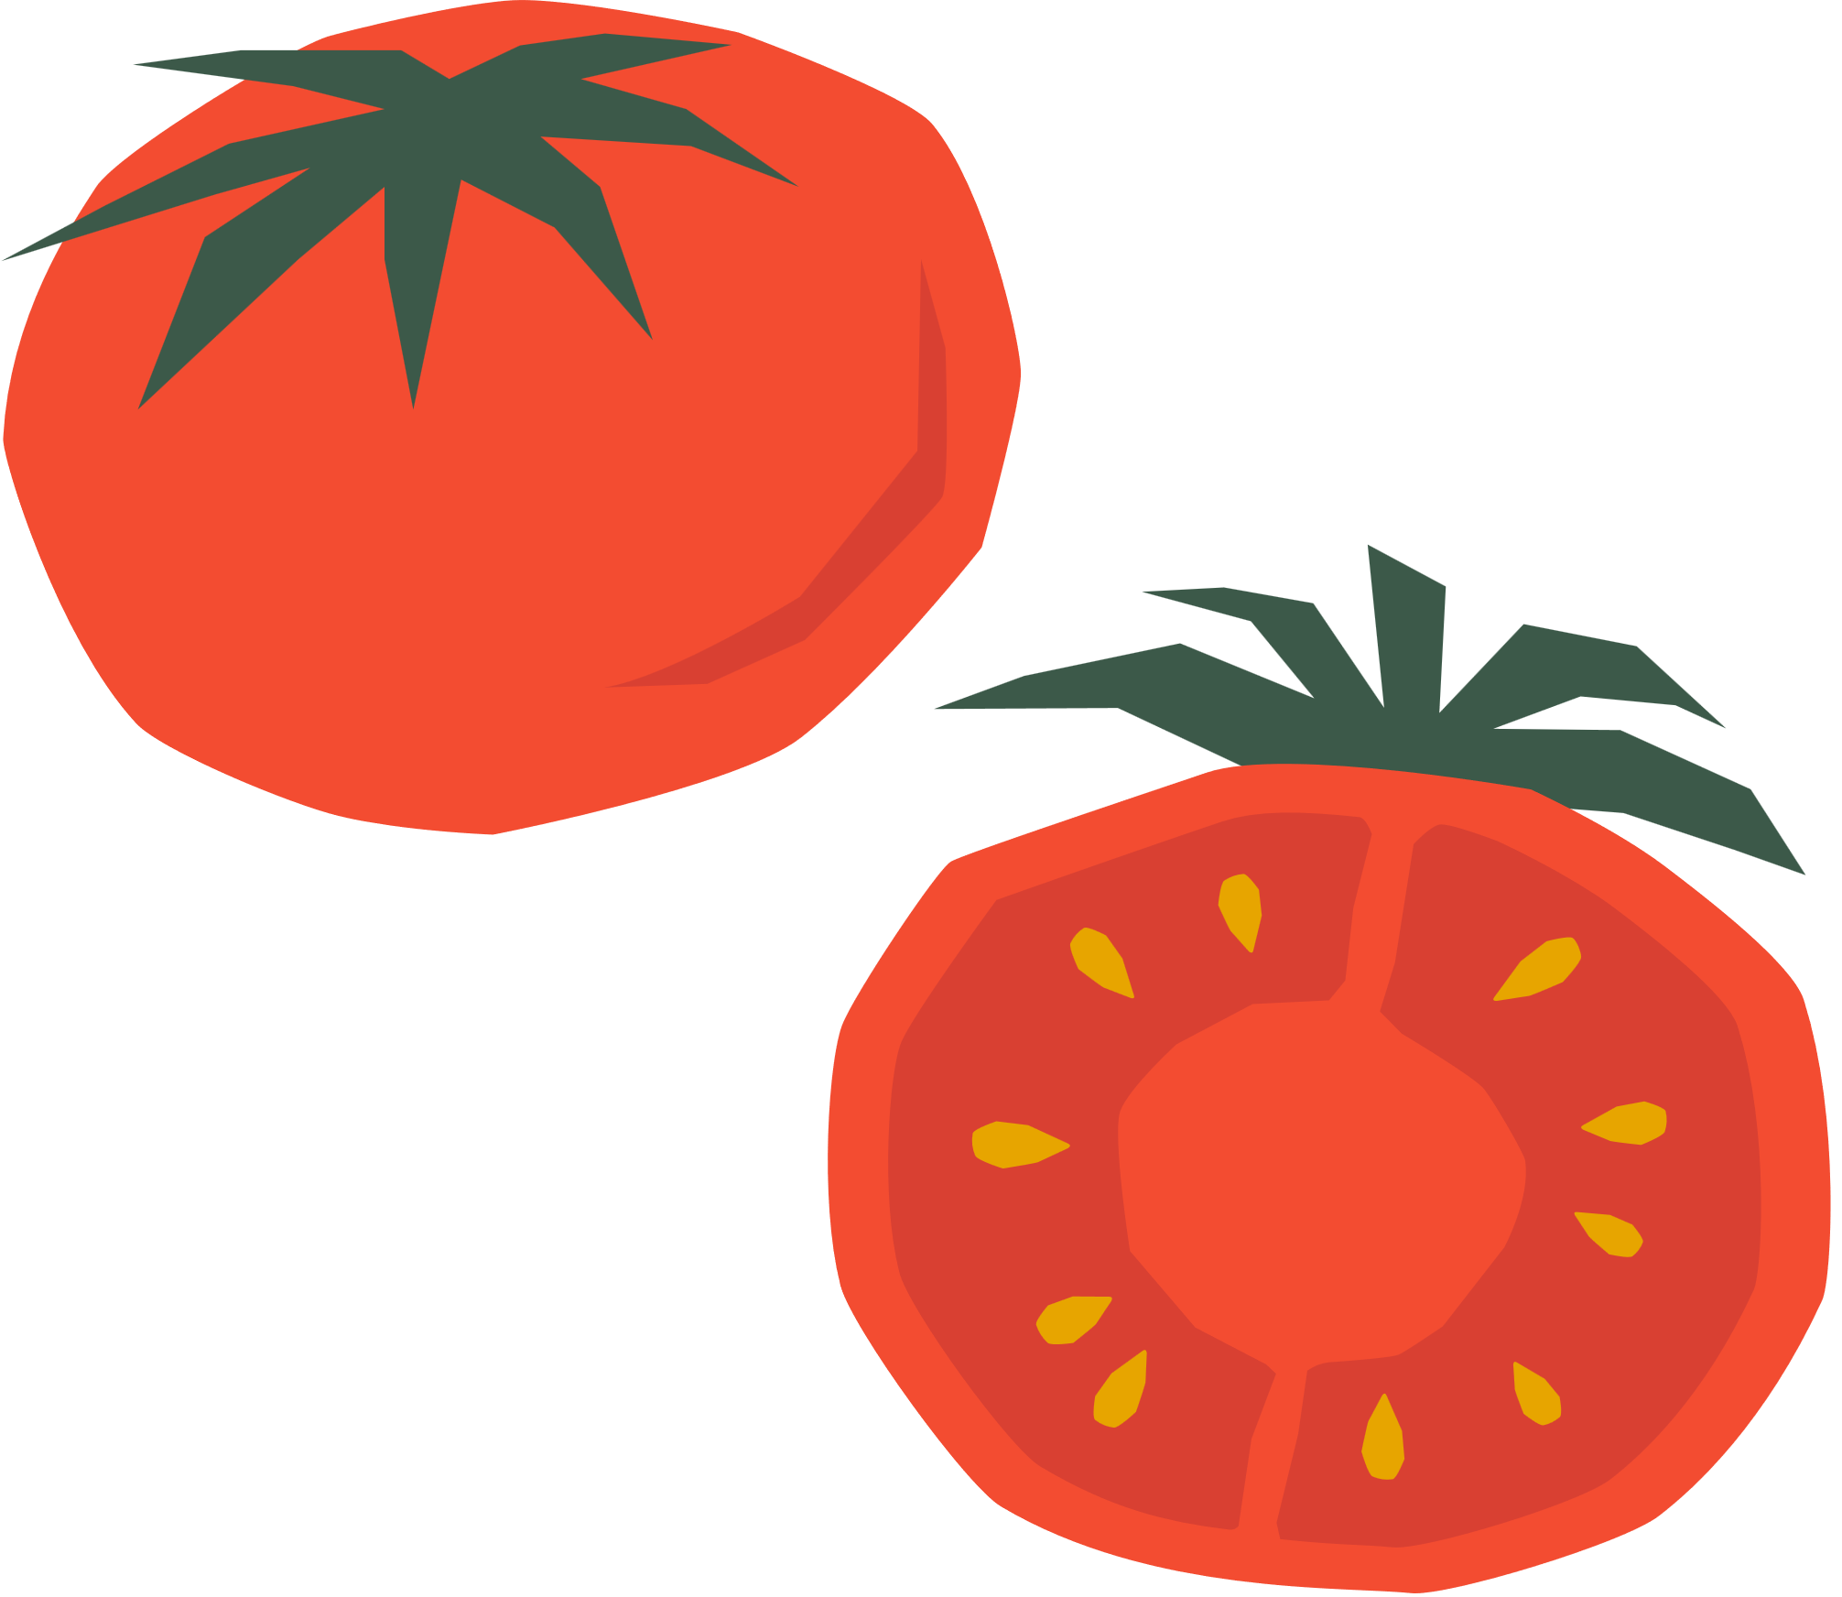
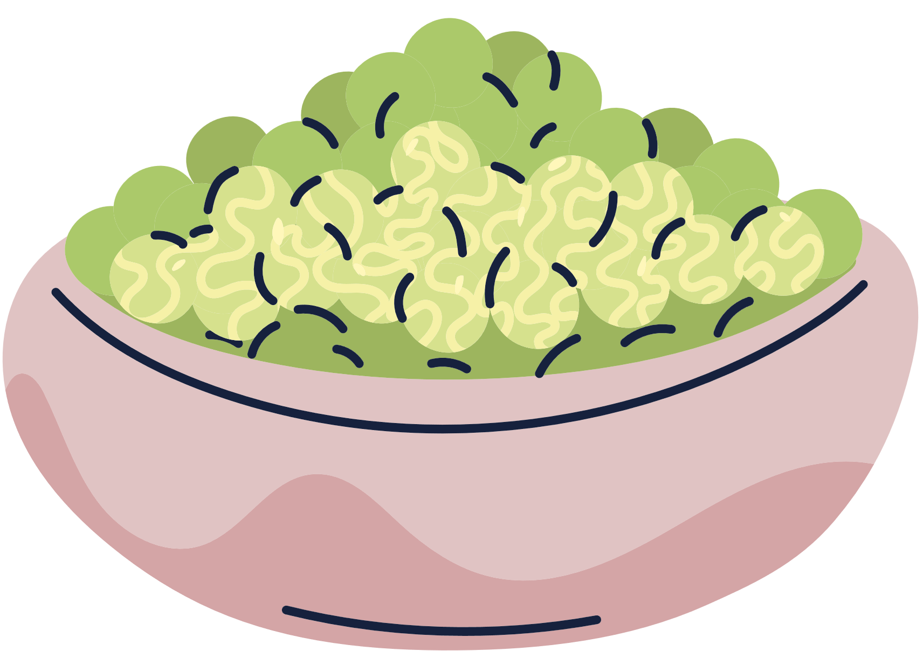

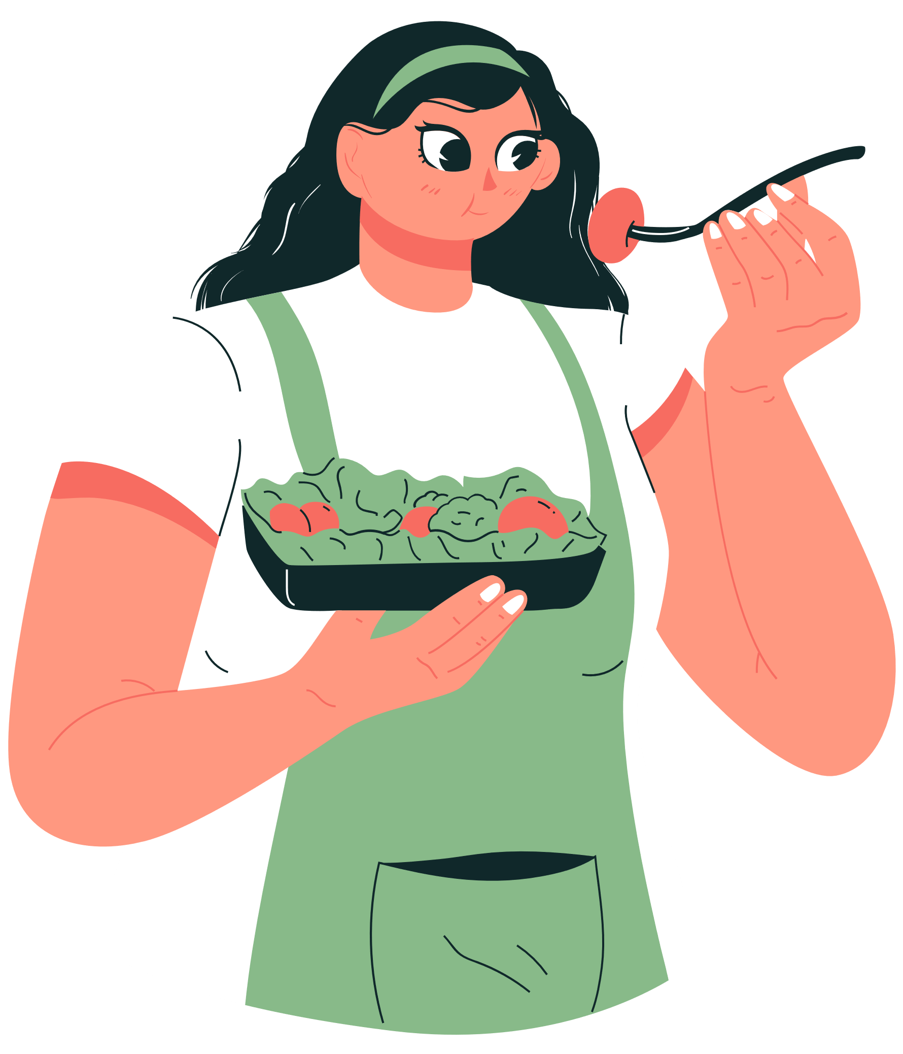
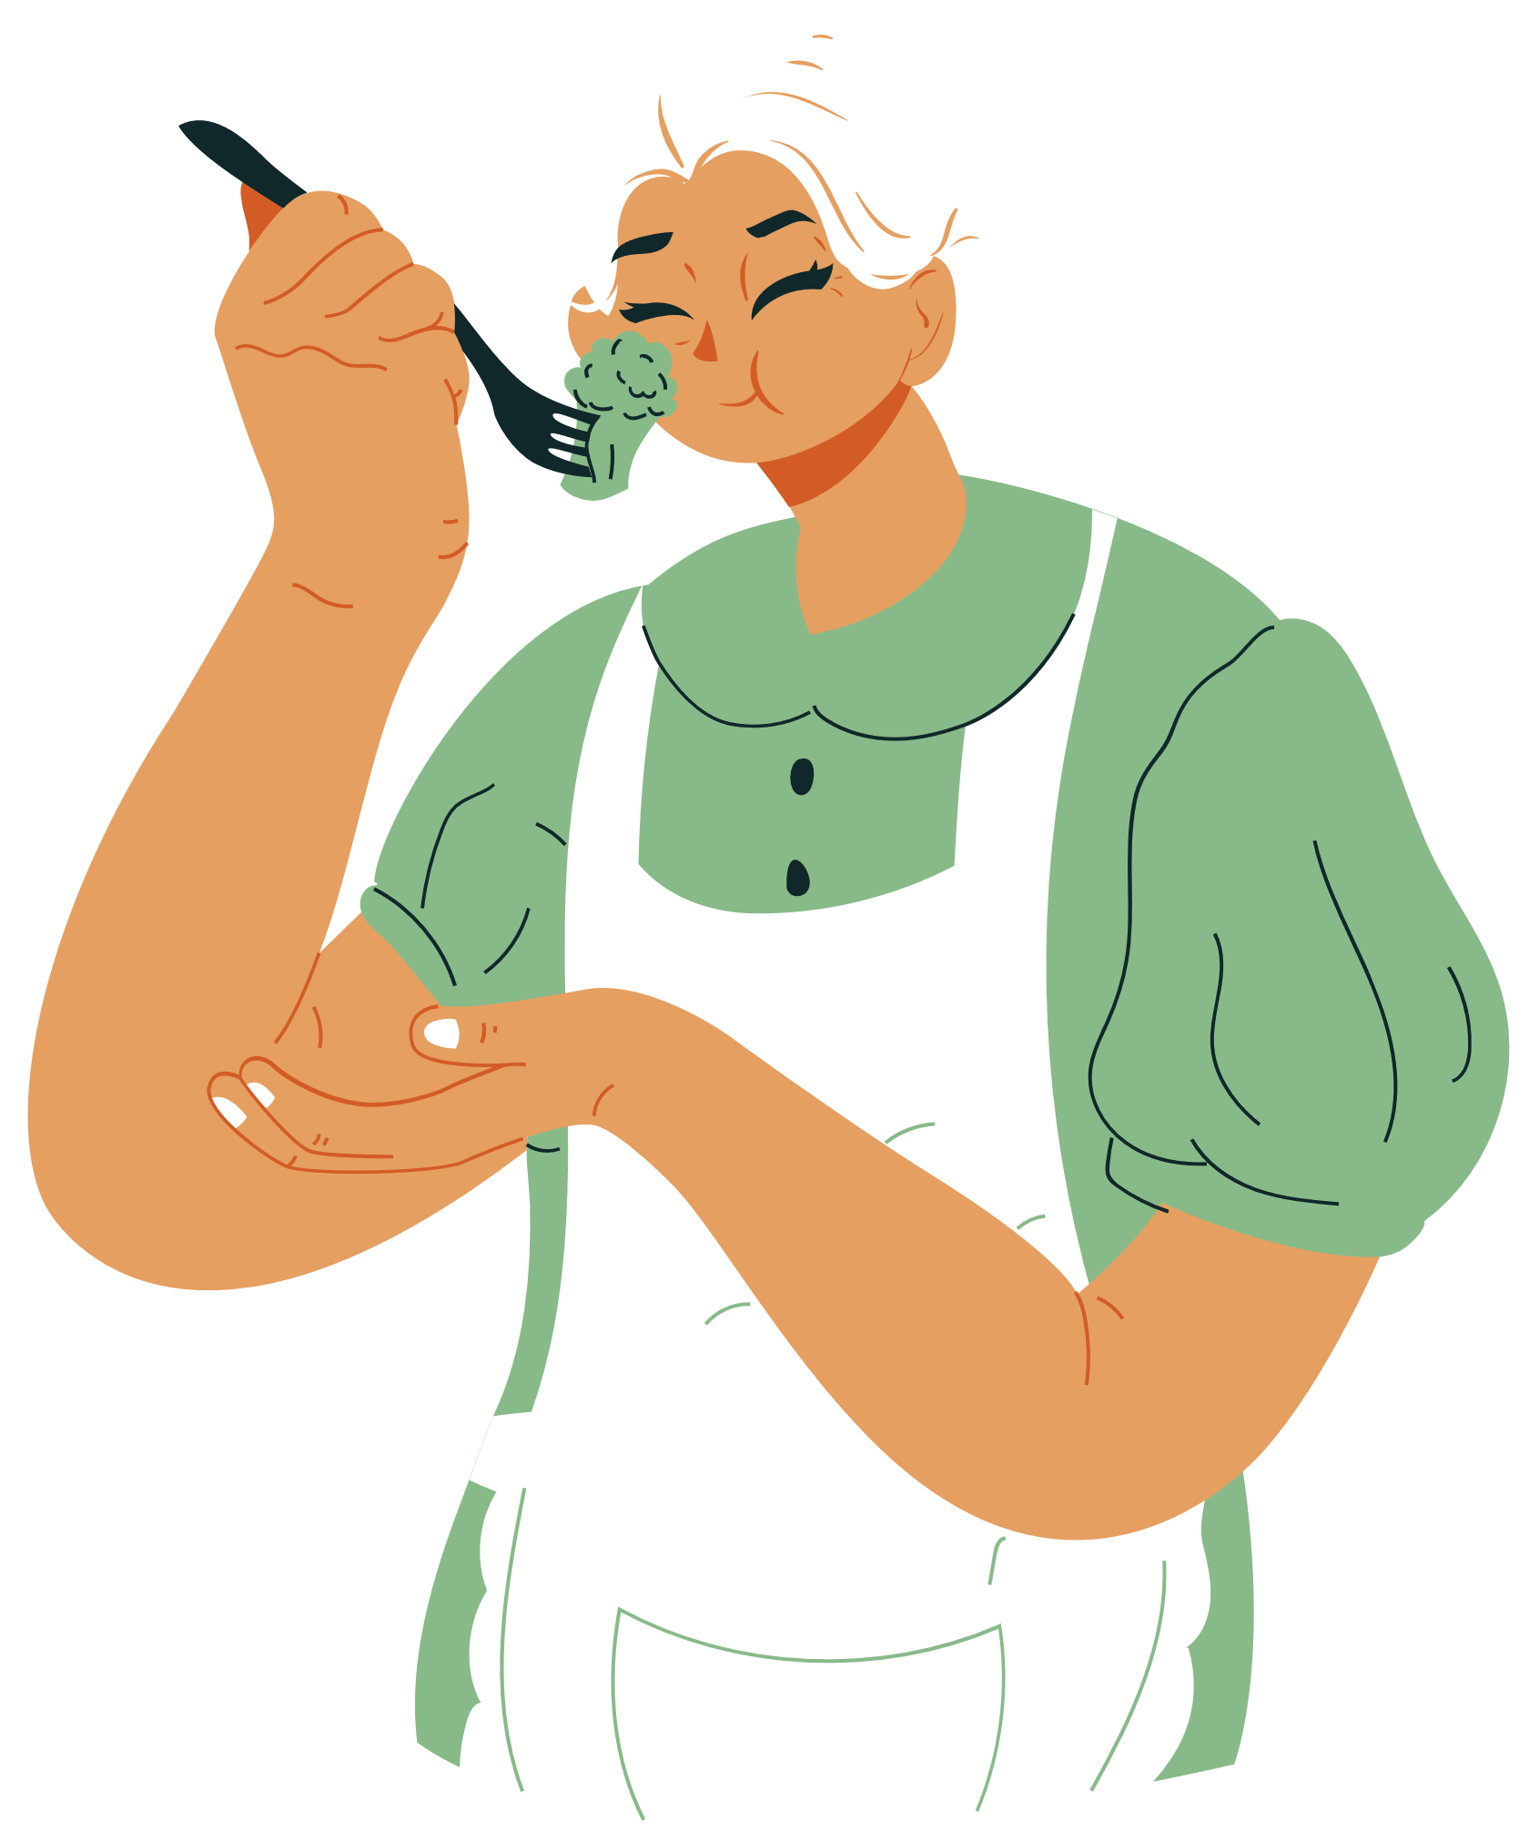
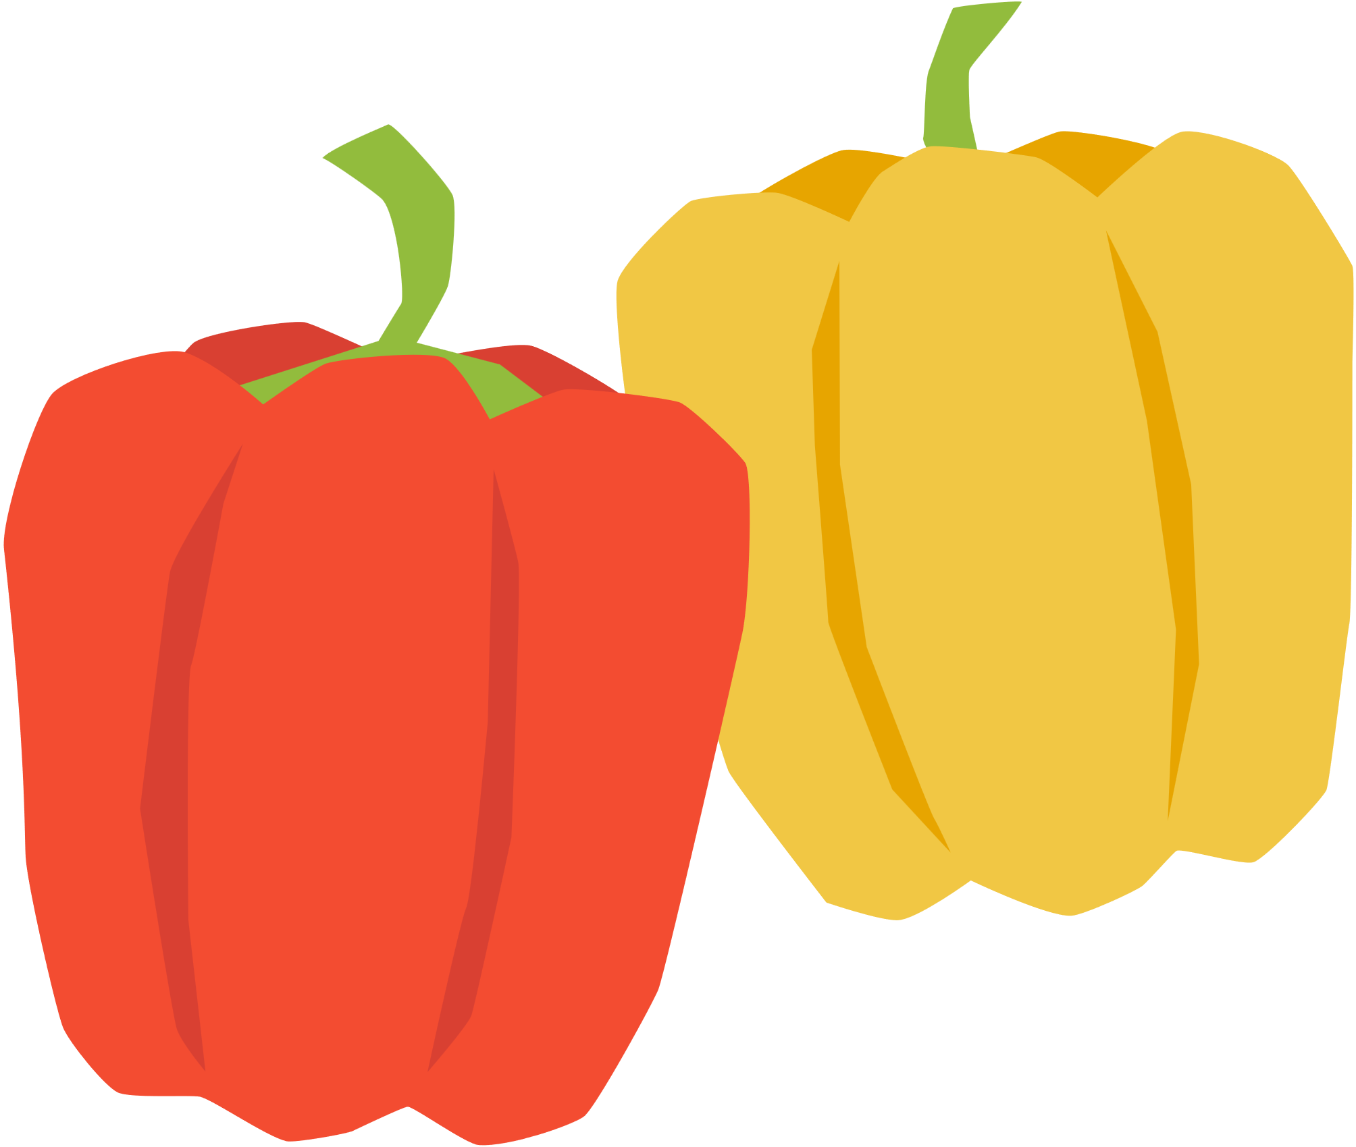
Let’s discuss!

Slide 10
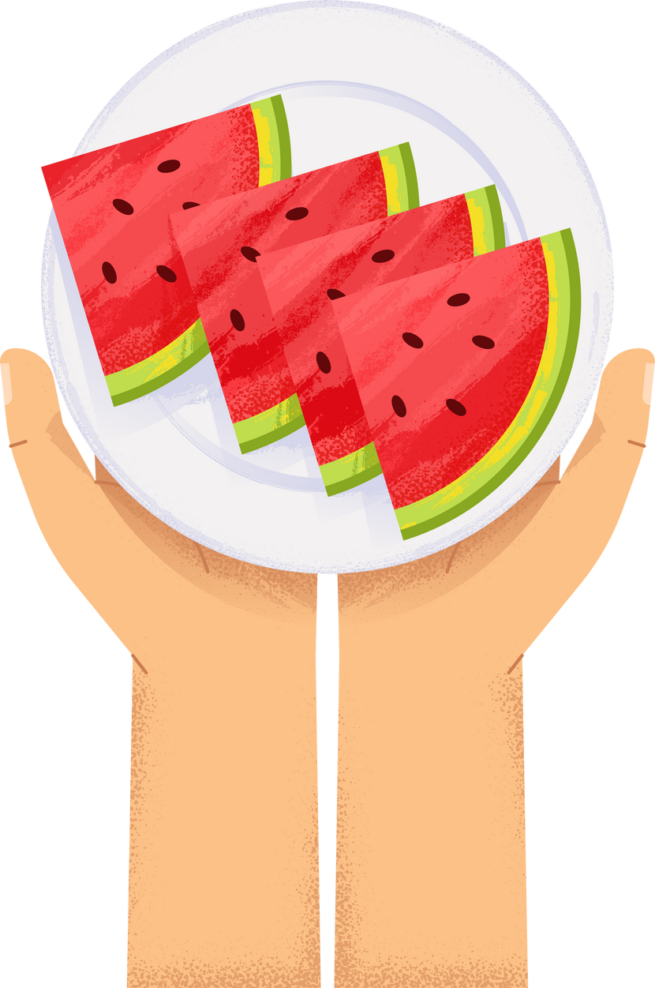
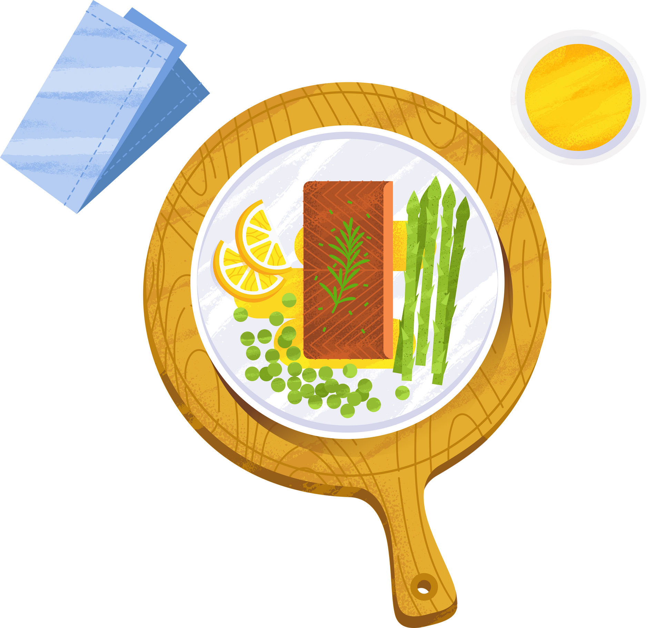
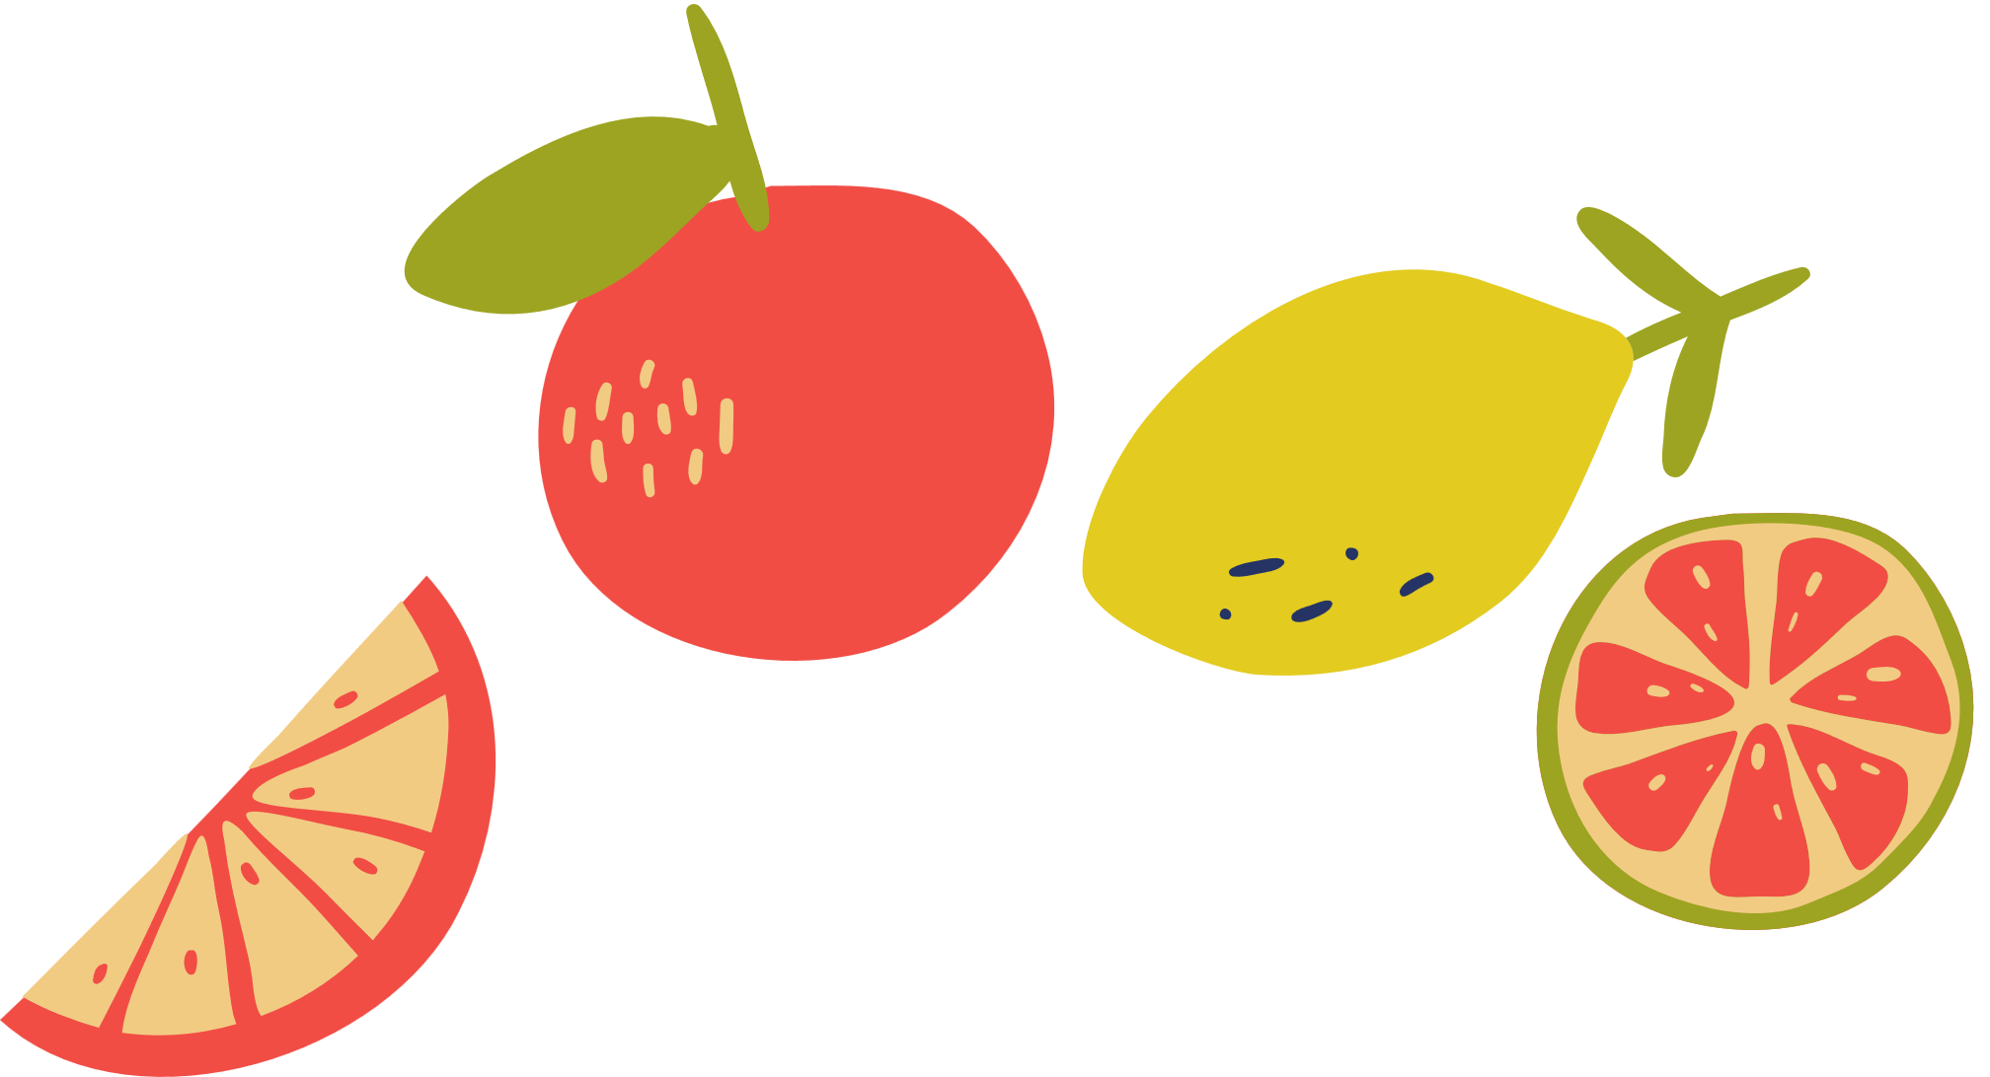
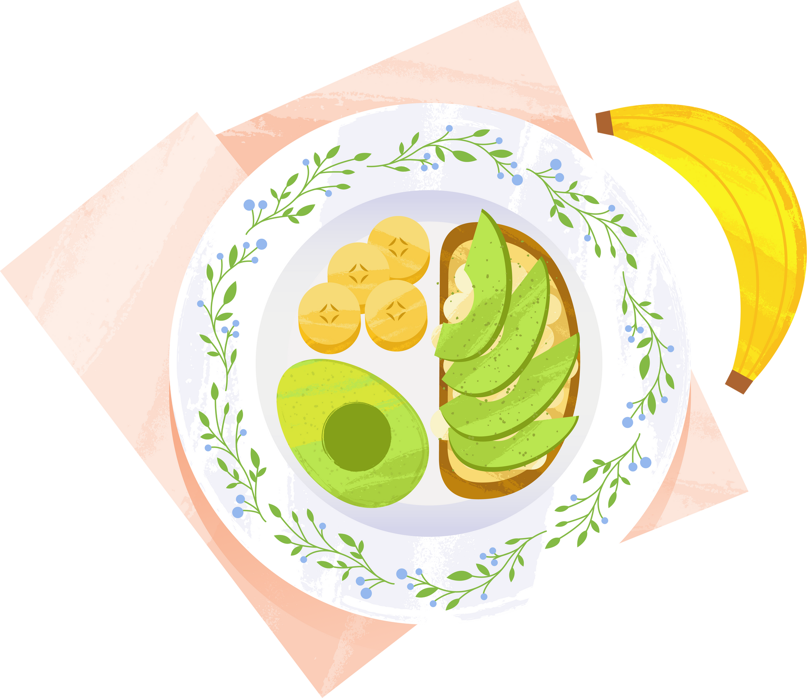
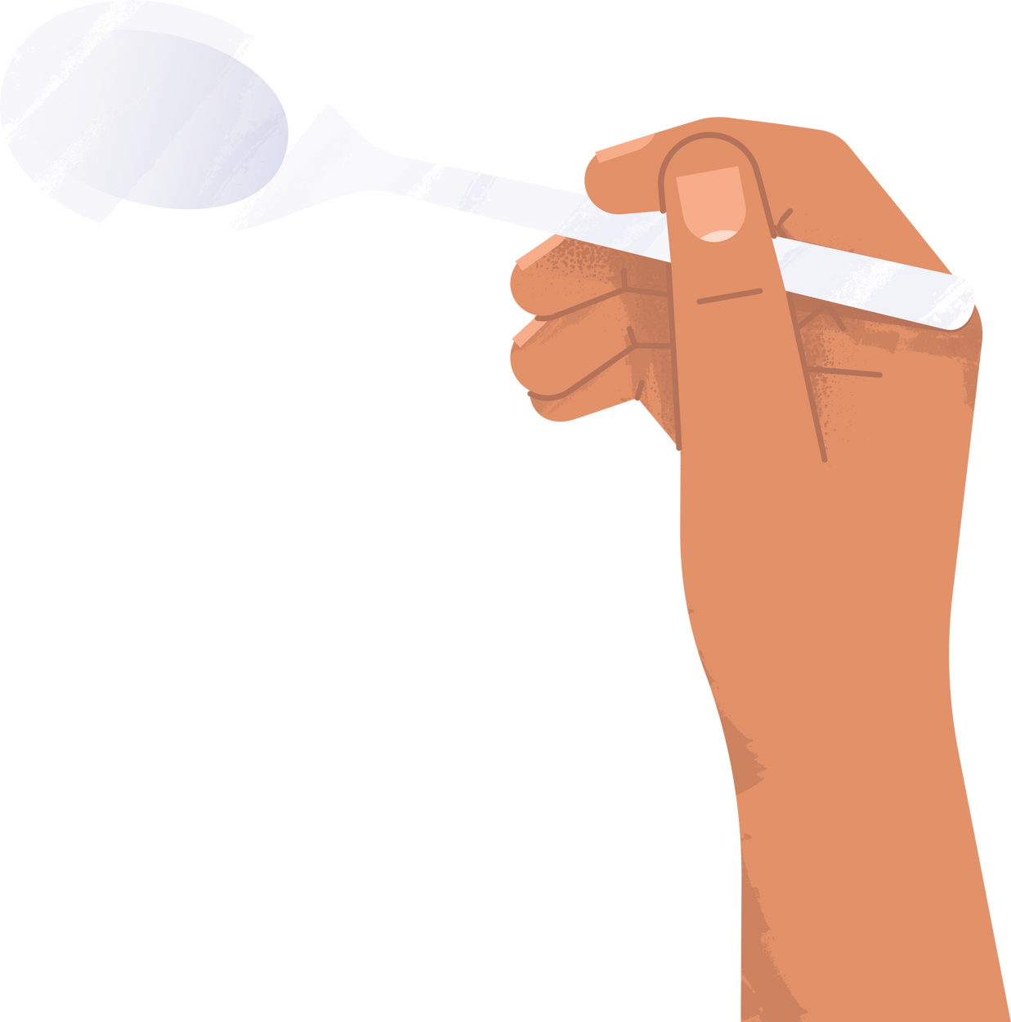
Discussions
Can you think of any foods that look sweet but taste sour or bitter?
How do you think the sense of smell affects the way we enjoy food?
How can the way food is prepared (like cooking it or serving it) change the way we taste it?
Have you ever eaten something that looked like it would taste one way, but it tasted completely different?

Slide 11
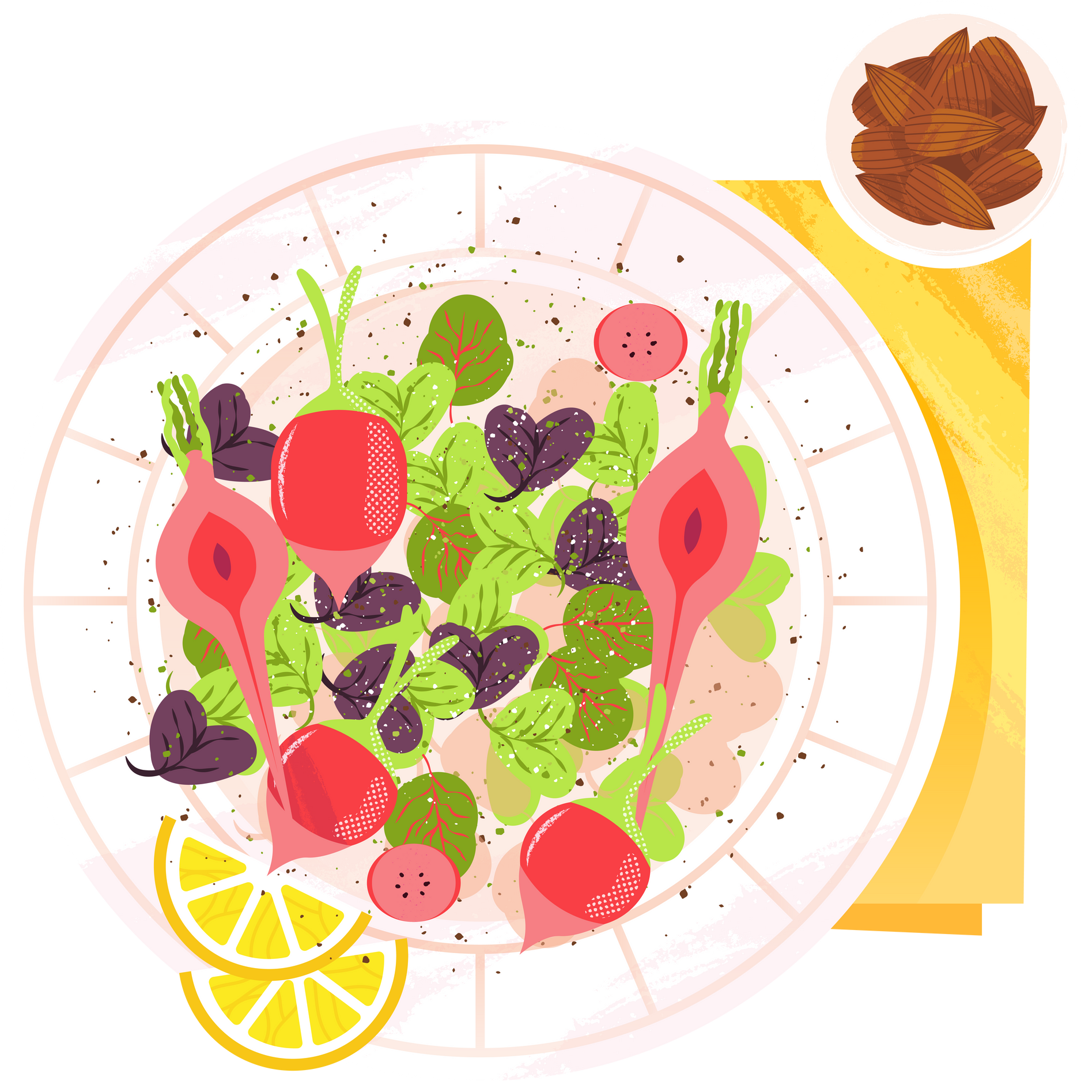
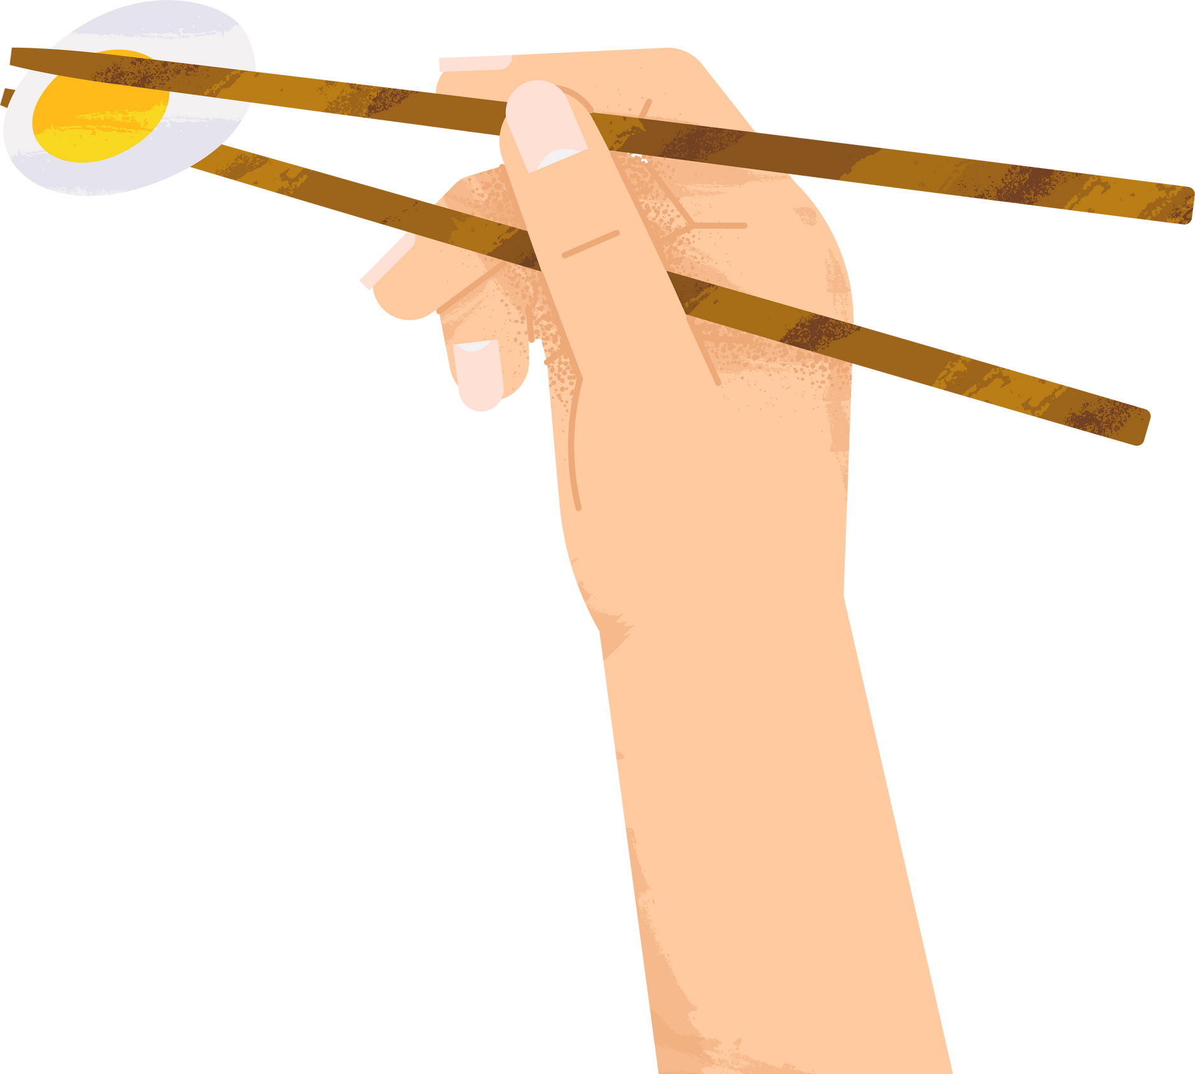

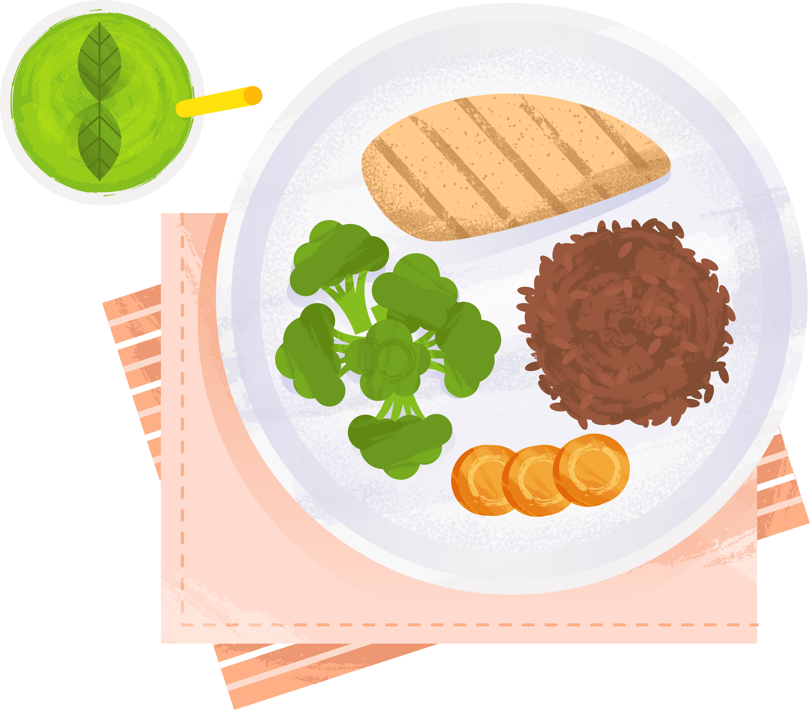
THANK YOU
See you next week!

